Slide 1

MEC2-M10 eTwinning Project
Brief sightseeing of France with our Angoulême friends

Slide 2
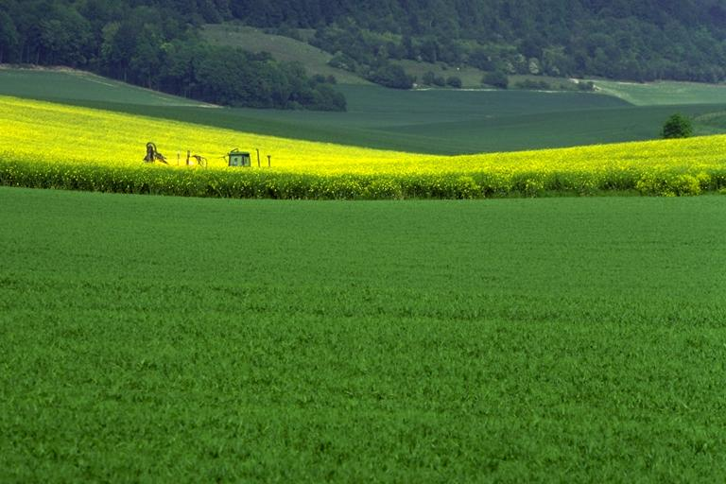

Picture by Kevin. Voice by Jordi

Slide 3
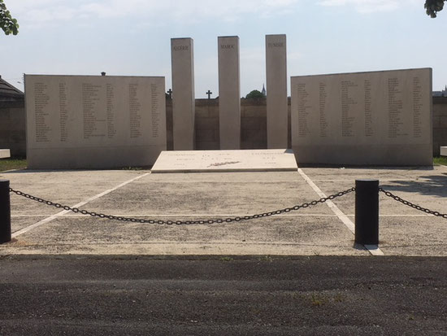
Picture by Arnaud. Voice by José Antonio

Slide 4
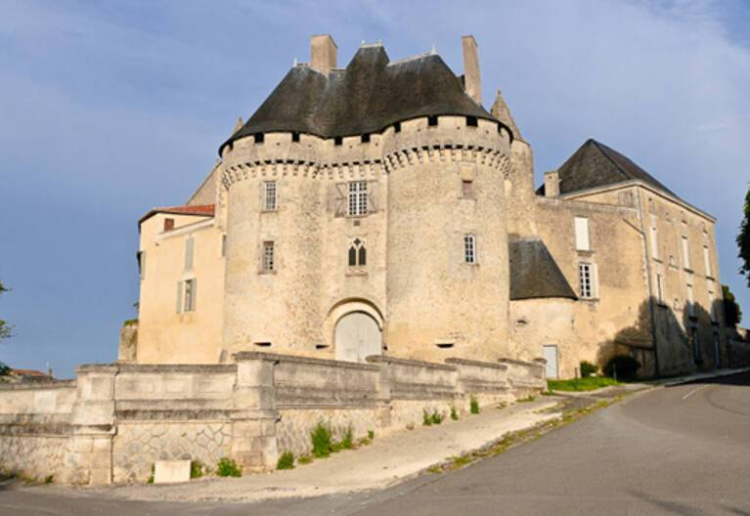
Picture by Thomas. Voice by Pol

Slide 5
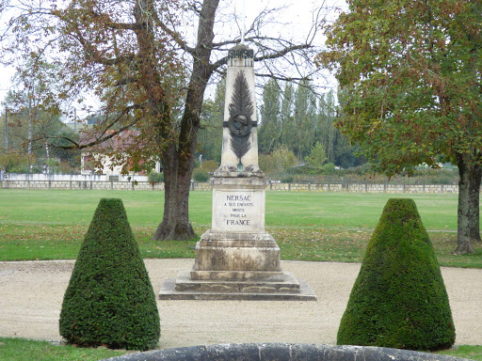
Picture by Elouan. Voice by Kacper

Slide 6
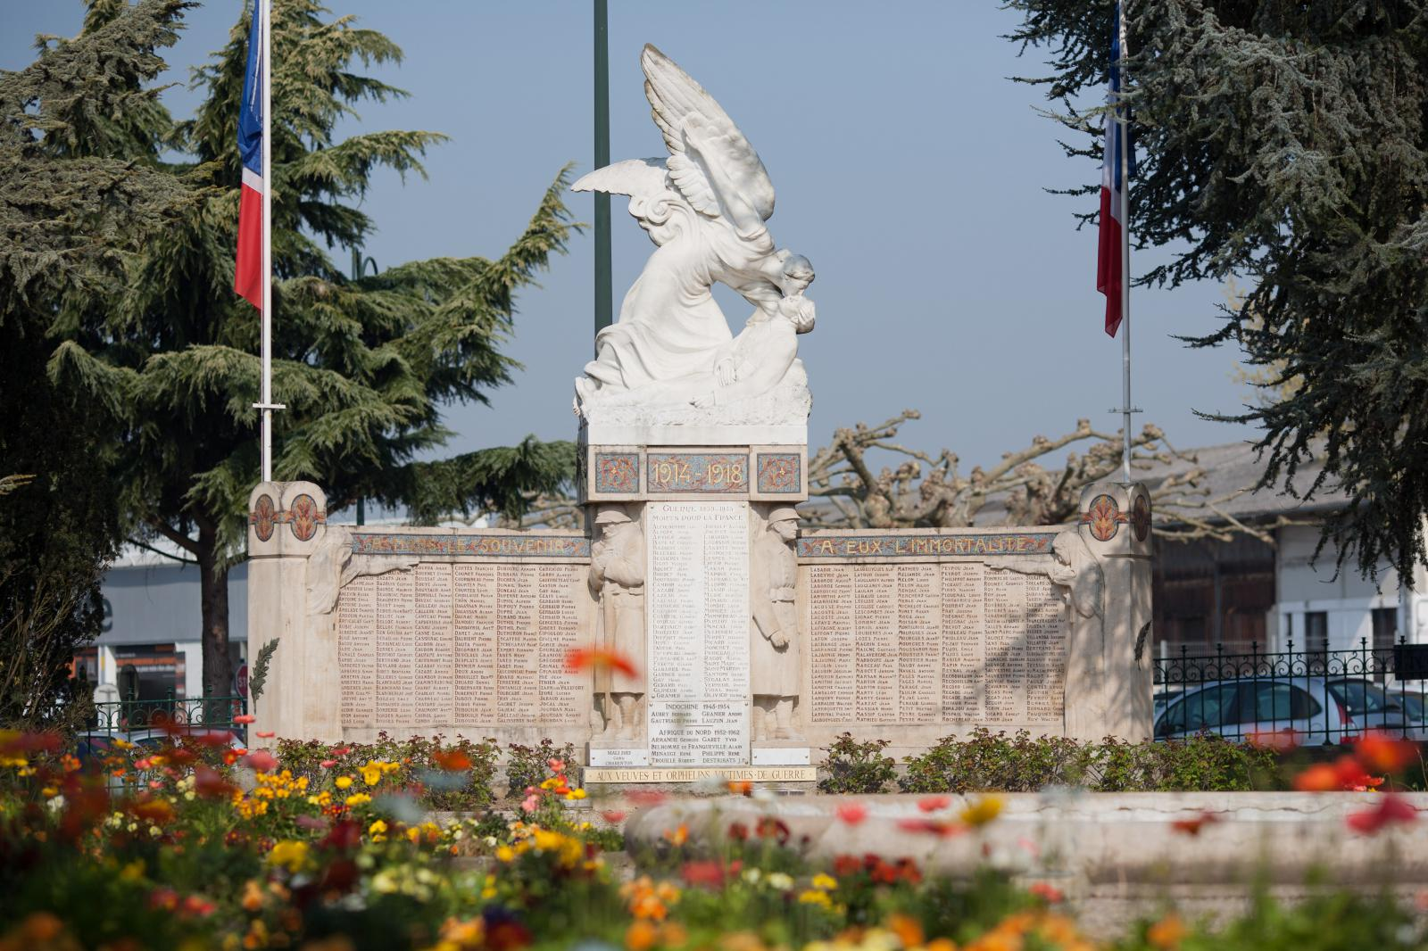
Picture by Romain. Voice by Yassine

Slide 7
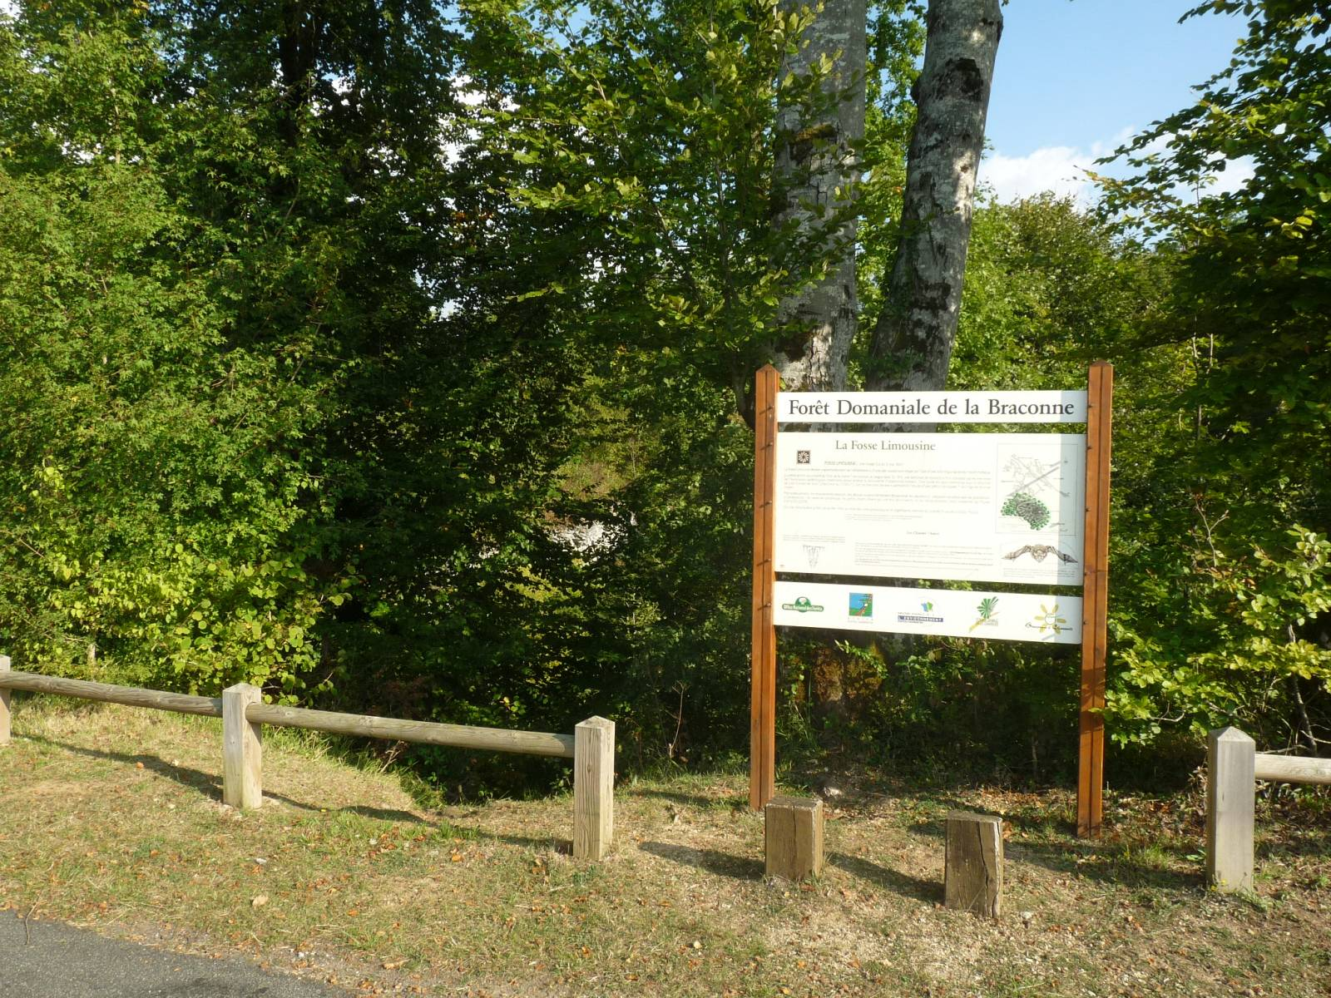
Picture by Romaric. Voice by Genís

Slide 8
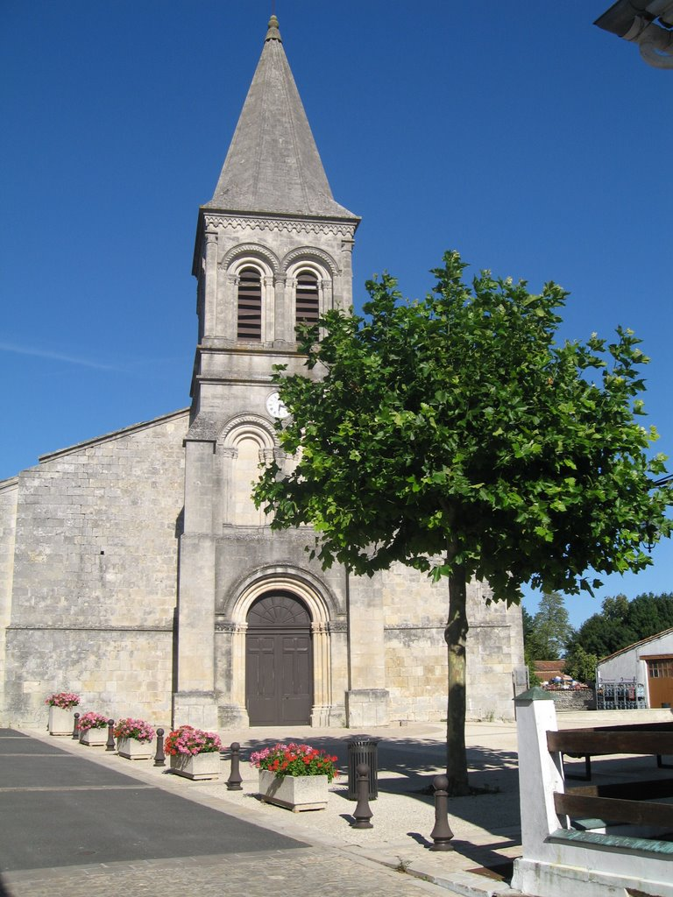
Picture by Jeremy. Voice by Camilo

Slide 9
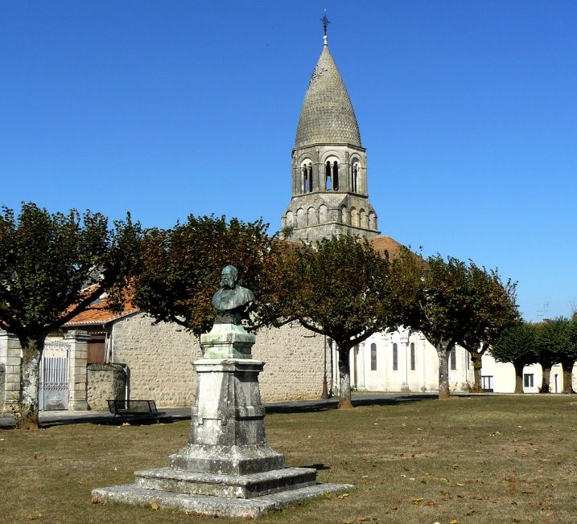
Picture by Mathys.
Voice by Dídac

Slide 10
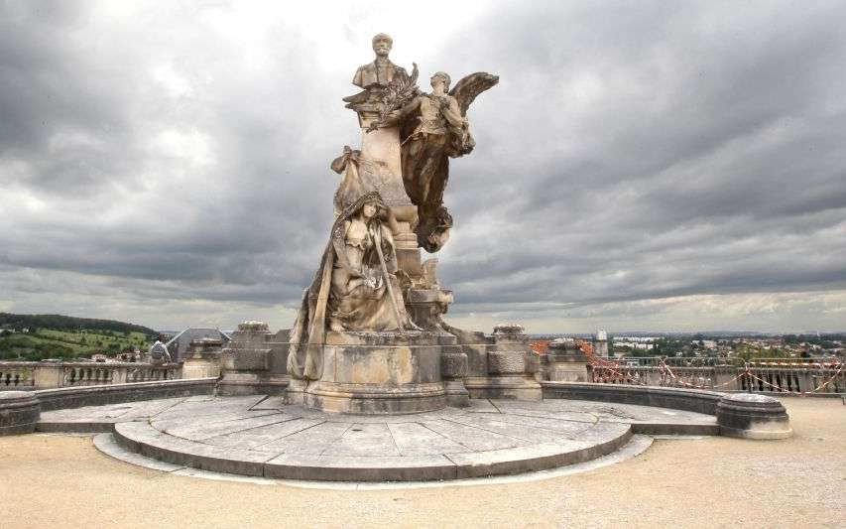
Picture by Zumeo. Voice by Fernando Egea

Slide 11
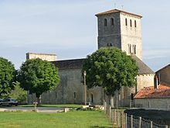
Picture by Clement. Voice by Guillermo

Slide 12
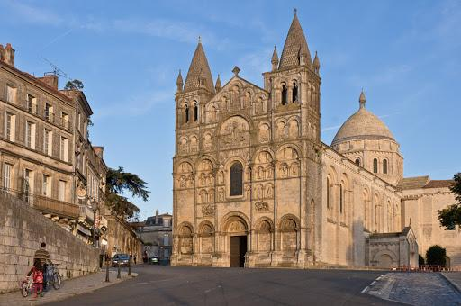
Picture by Baptiste. Voice by Aleix

Slide 13
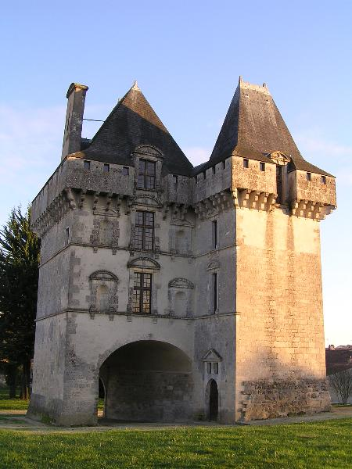
Picture by Anthony. Voice by David

Slide 14
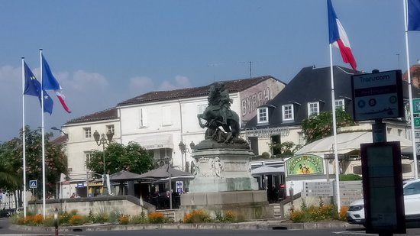
Picture by Philippine. Voice by Eduard

Slide 15
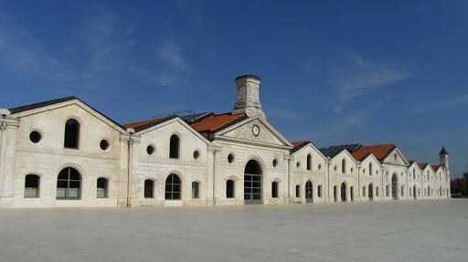
Picture by Jason. Voice by Fernando Castillo

Slide 16
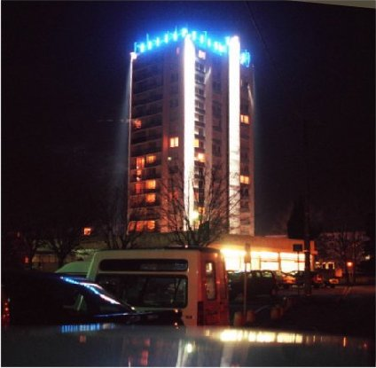
Picture by Tom. Voice by Pau

Slide 17
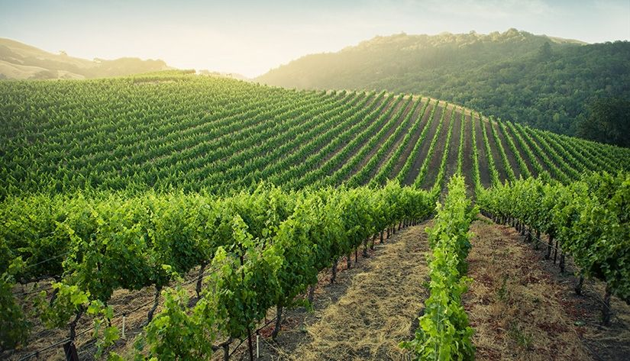
Picture by Amèlie. Voice by Kevin

