Slide 1
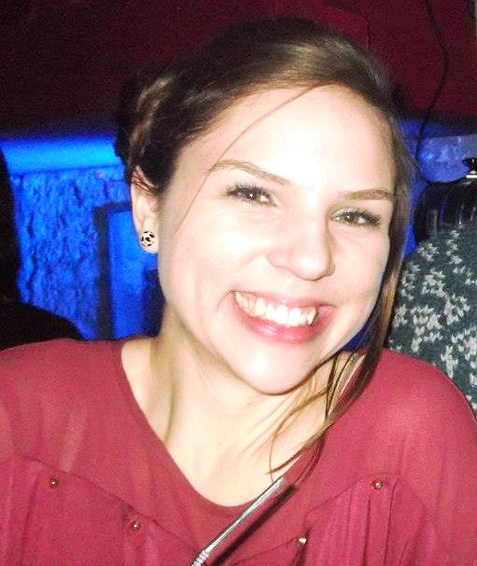
Louise Benton
Introduction
Notes:
<numéro>

Slide 2
Louise Benton
Louise lives in Birmingham in England.
She lives in Angoulême now.
She is an English assistant.
She works at the collège on Tuesdays.

Slide 3
Louise is twenty-three years old, she's young.

Slide 4
Louise family
Louise has a brother and three sisters.
Their names are Emily, Claire and Alice. Her brother is Simon.

Slide 5
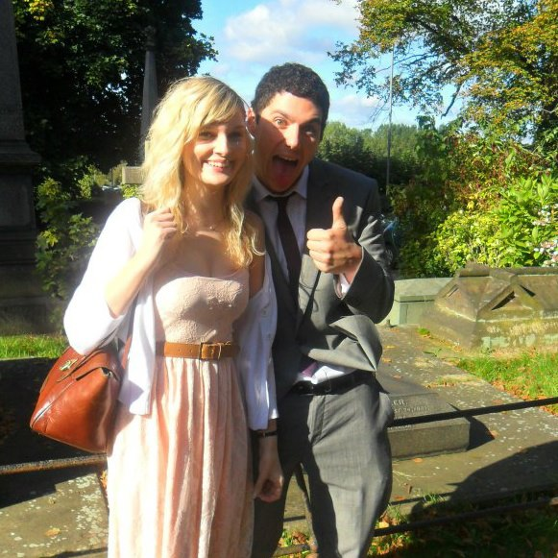
Emily, her sister.
Emily has a boyfriend.

Slide 6
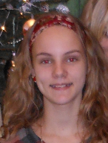
Claire, her sister.
Claire is beautiful.

Slide 7
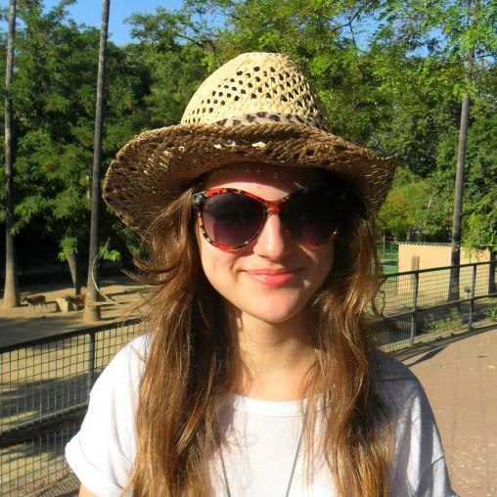
Alice, her sister.
Alice is young.

Slide 8
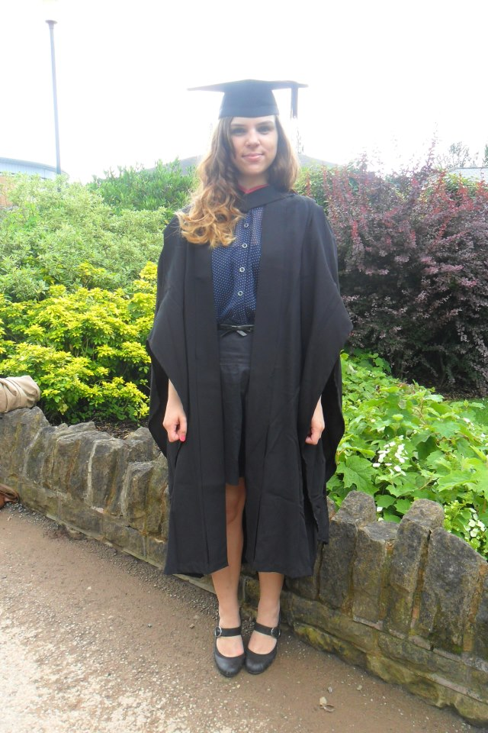
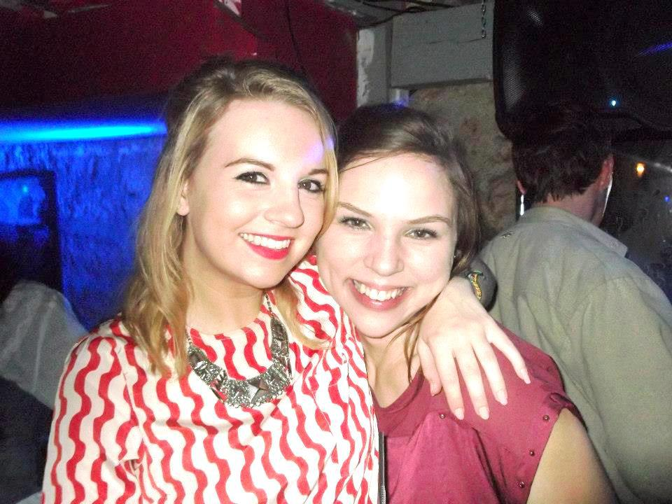
Louise
Louise and her friend.
Louise, a traditional student.

Slide 9
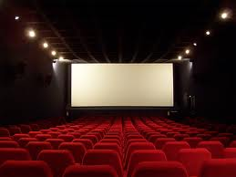
Her tastes
Louise likes red and going to the cinema with her friends.

Slide 10
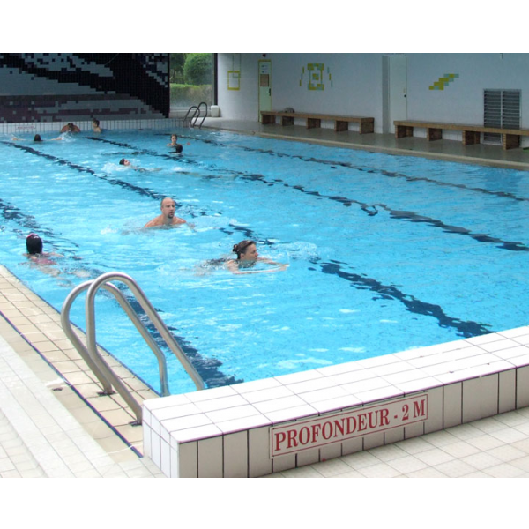
Her favourite sport is swimming.

Slide 11
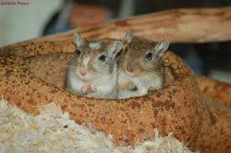
She has two gerbils.

Slide 12
Thank you.
Slide show done by
Marine Pailloux and Ambre Mazouin.
They are in 6 B.

