Slide 1
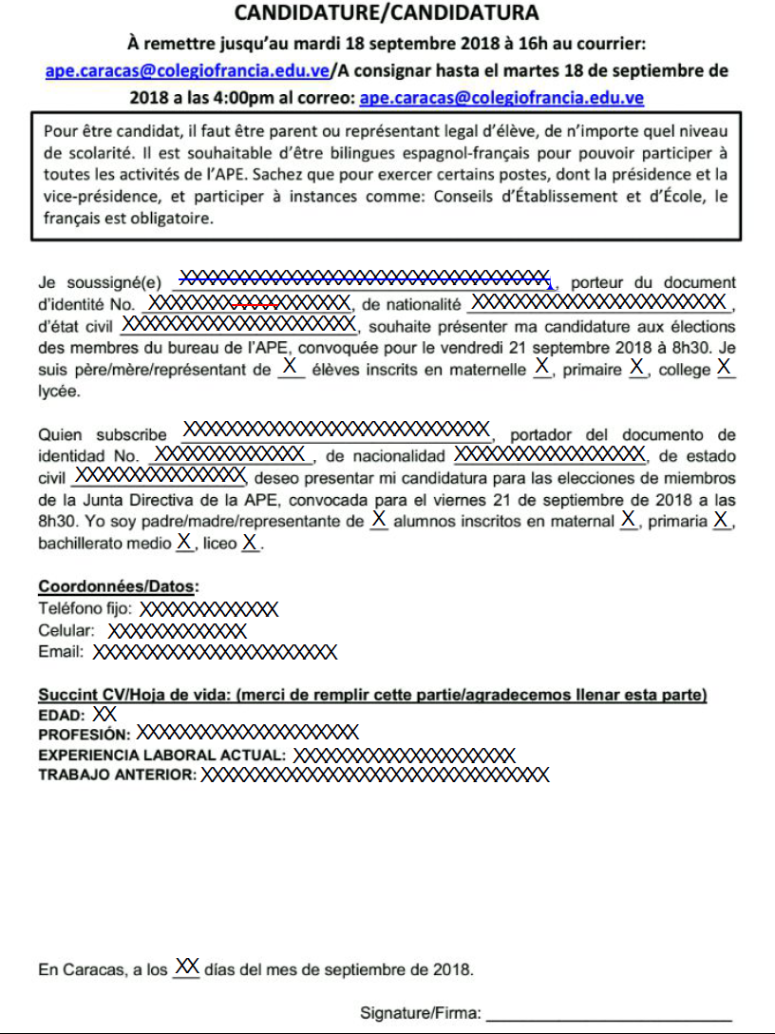
Lusliany Rondon
Vénézuélienne
C.I. 14.690.103
célibataire
3
0212 2574329
0414 2920118
luslianyrondonv@hotmail.com
39
Nutricionista
Investigadora IVIC
Investigadora IVIC
15
Lusliany Rondon

